Slide 1

Course Overview and Introduction
23CSE473 Neural Networks and Deep Learning 3- 0- 0- 3

Slide 2
Course Objectives
To introduce to students,
Different deep neural network architectures,
Training strategies/algorithms, possible challenges, tools and techniques available in designing and deploying solutions to different practical/ Engineering problems.

Slide 3
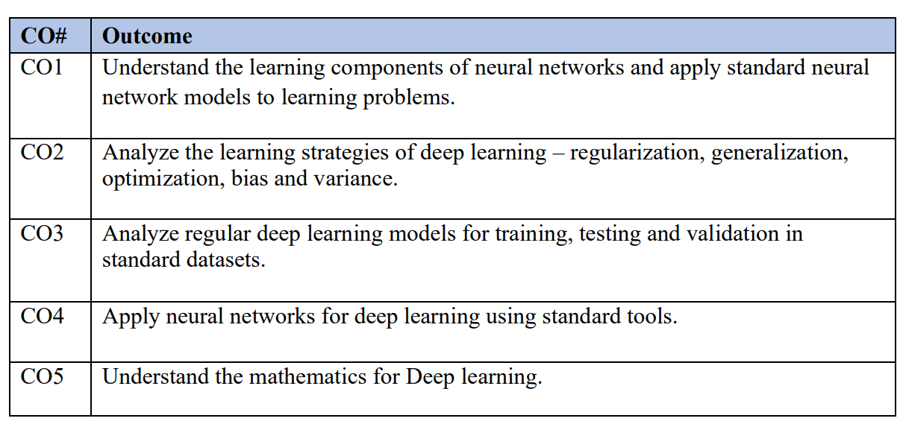
Course Outcomes
After the course completion, the students will be able to,

Slide 4
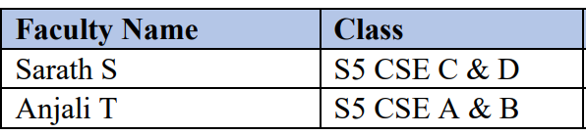
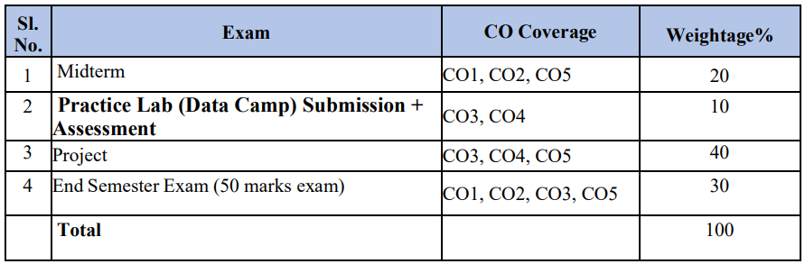
Course Instructors & Evaluation Policy

Slide 5
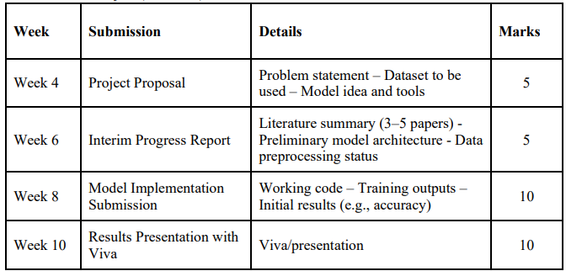
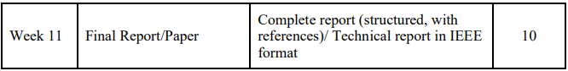
Project Deliverables

Slide 6
Deep Learning Models ( Big Picture)
Deep Neural Networks
Neural Networks
Deep Neural Networks/Feed forward Networks
Convolutional Neural Networks( CNN)
LeNet
AlexNet
VGG
ResNet
GoogleNet
Object Detection models
RCNN
Yolo
Generative models
Generative Adversarial Networks,(GAN)
Sequential Models
RNN
LSTM
Encoder – Decoder models
Attention mechanism
Transformers
Transformers, Transformer-XL, Masked Language Modelling
Autoregressive models
Time series forecasting
Generative Pre-trained Transformer 3
(GPT-3)
NADE, MADE(Masked Autoencoder Density Estimator), PixelRNN

Slide 7
Introduction to Computer Vision

Slide 8
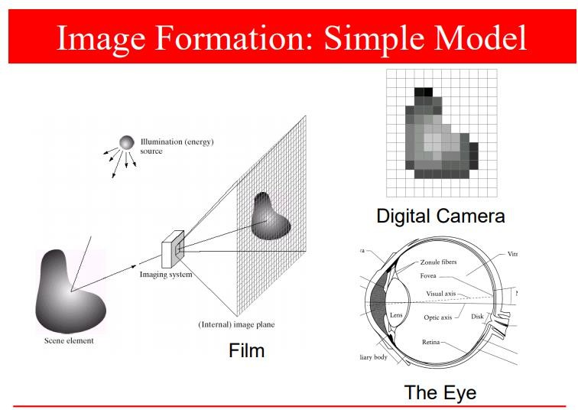
I

Slide 9
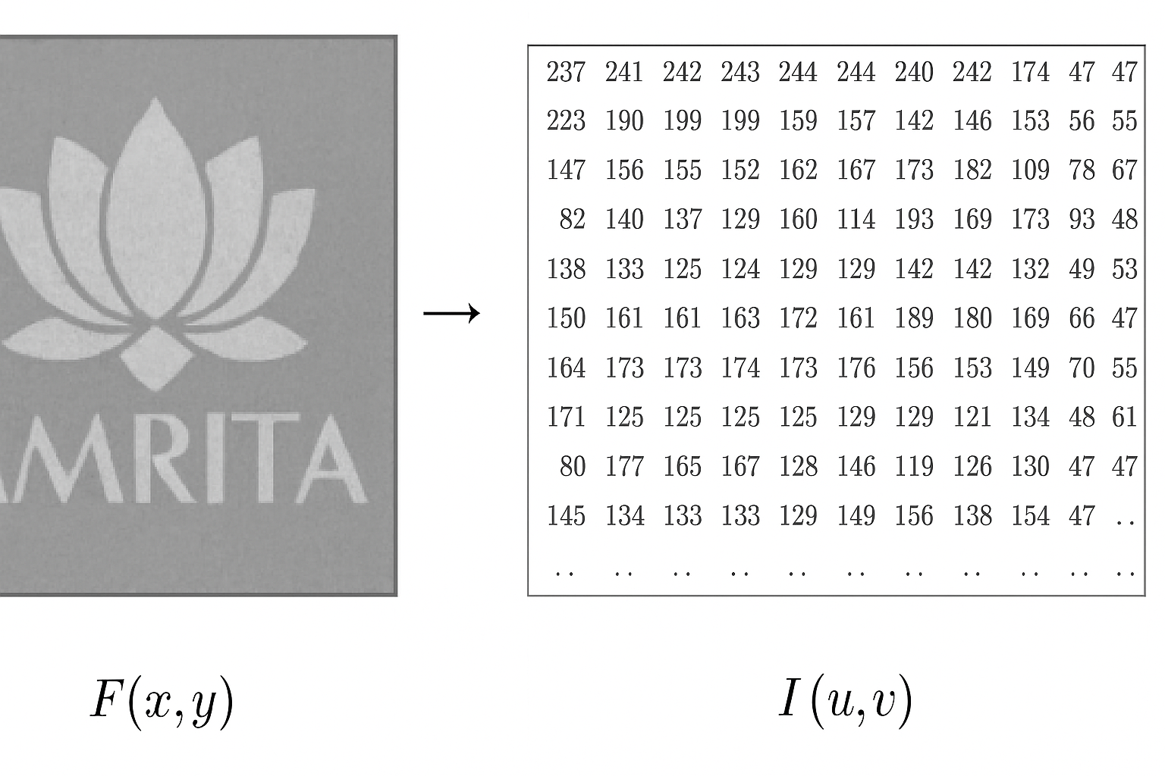
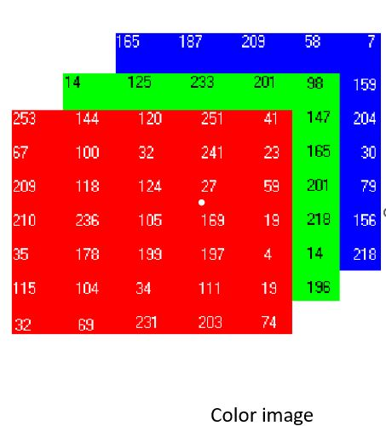
Image Matrix- pixel,resolution( spatial, graylevel)
Gray Scale image 8 bit gray scale image 0-255 0-black, 255- white

Slide 10
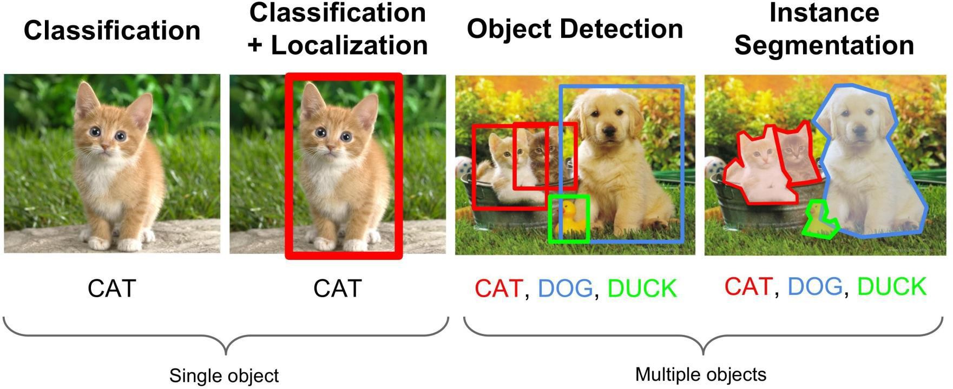

Slide 11

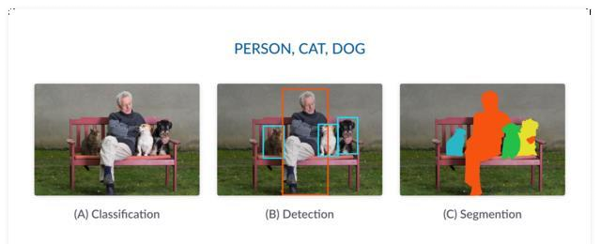


Slide 12
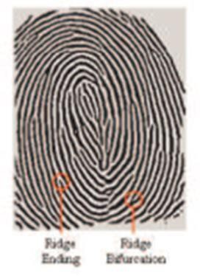

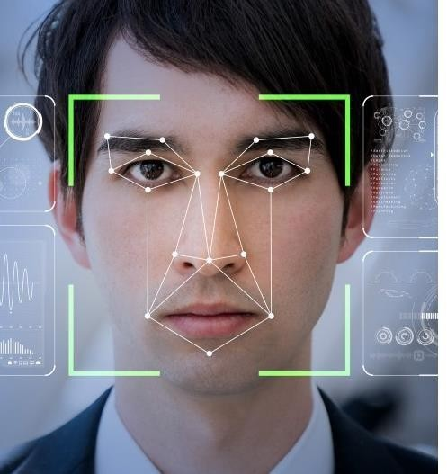
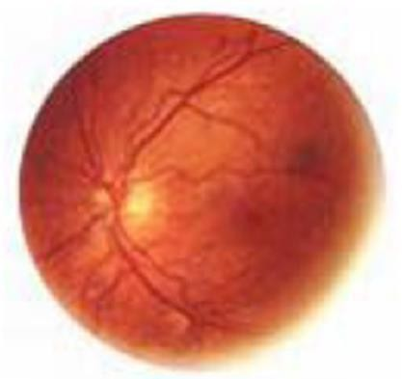

Biometric Applications

Slide 13
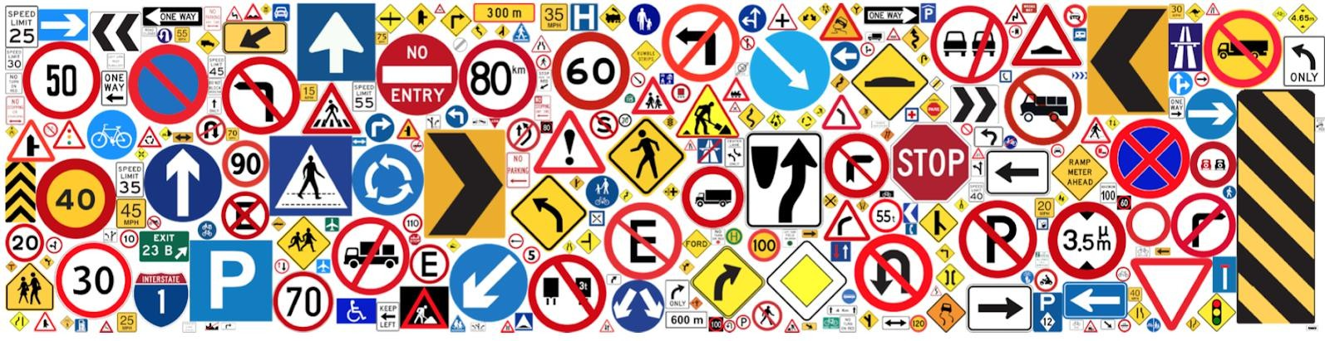
Traffic Sign Recognition

Slide 14
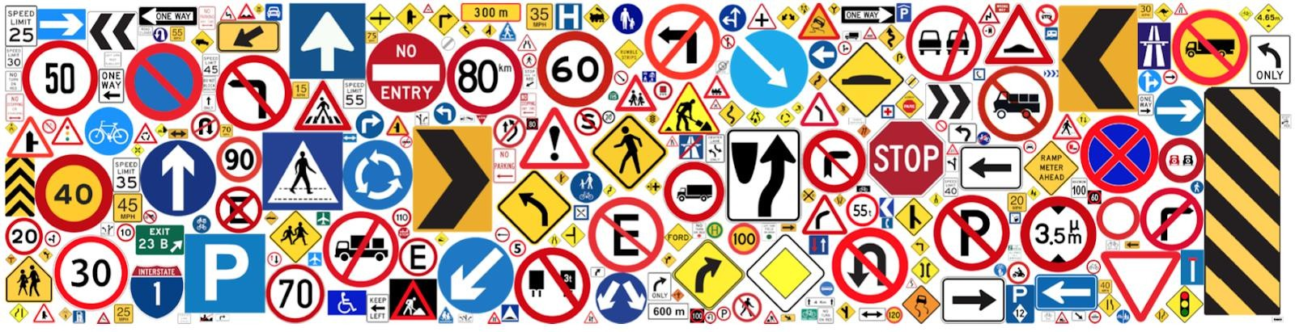
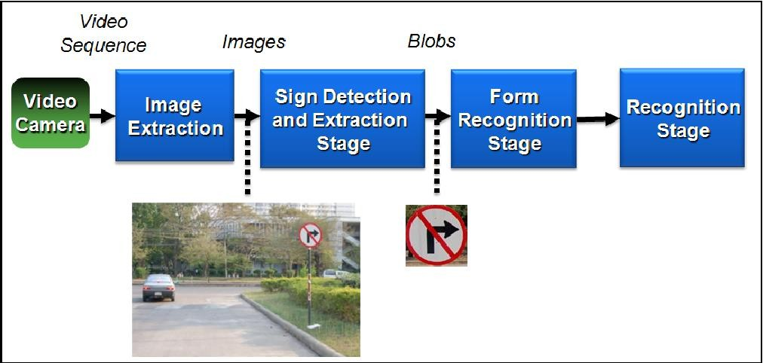
Traffic Sign Recognition

Slide 15







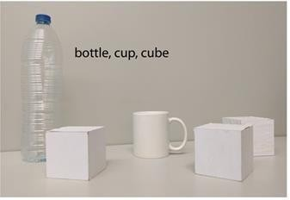


Key Steps in image analysis
Image
Acquisition
Image
Enhancement
Image
Segmentation
Feature Extraction
Object Recognition/ Machine Learning

Slide 16
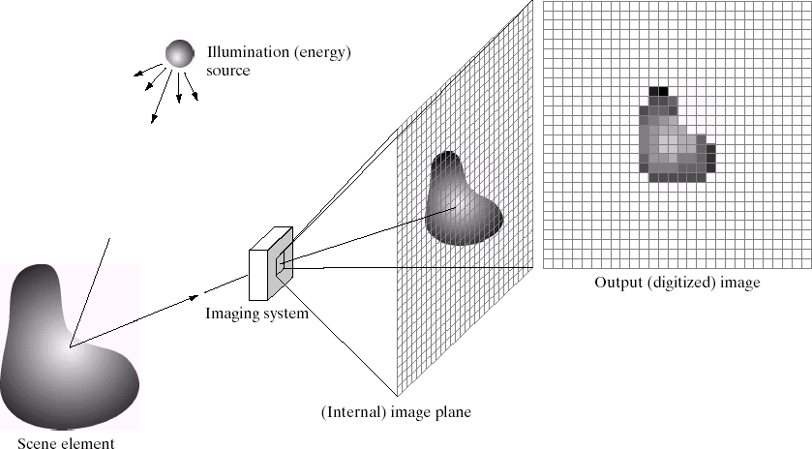

Image Acquisition
Image
Acquisition
Image
Enhancement
Image
Segmentation
Feature Extraction
Object Recognition/ Machine Learning

Slide 17

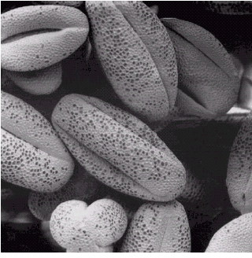
Image Enhancement
Image
Acquisition
Image
Enhancement
Image
Segmentation
Feature Extraction
Object Recognition/ Machine Learning

Slide 18
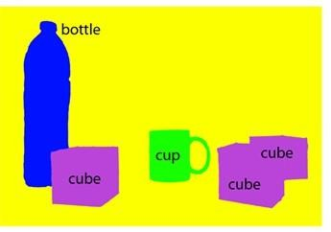
Image Segmentation
Image
Acquisition
Image Pre-
processing
Image
Segmentation
Feature Extraction
Object Recognition/ Machine Learning

Slide 19
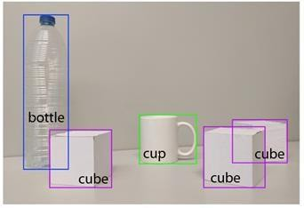




Feature extraction
Image
Acquisition
Image
Enhancement
Image
Segmentation
Feature Extraction
COLOR
TEXTURE
SHAPE
Object Recognition/ Machine Learning
ANY OTHER

Slide 20
Object Recognition
Image
Acquisition
Image
Enhancement
Image
Segmentation
Feature Extraction
COLOR
TEXTURE
SHAPE
Object Recognition/ Machine Learning
ANY OTHER

Slide 21

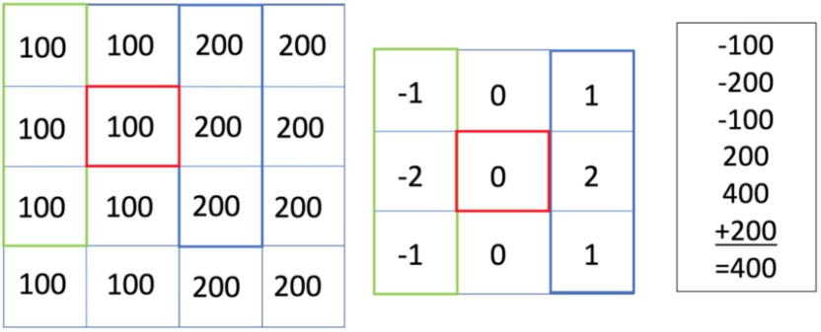
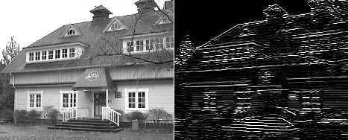
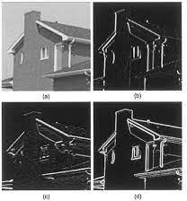
Convolution operation in images
Image
Kernel/Filter
Edge detection using sobel operator

Slide 22
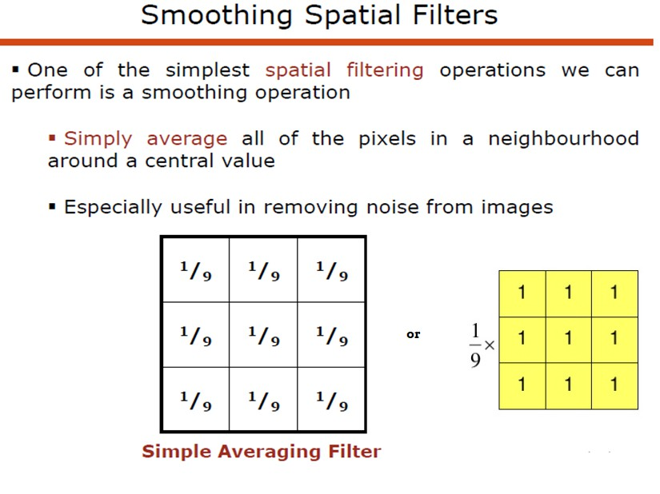

Slide 23
Feature Extraction and Classification

Slide 24
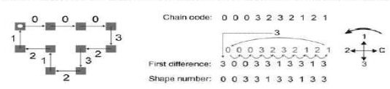
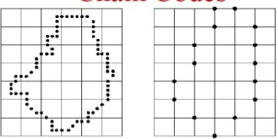
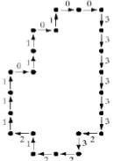
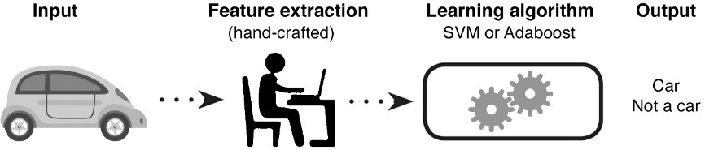
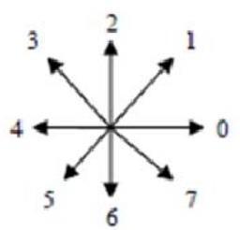
Feature Extraction- Hand Crafted
A simple example –chain code
Chaincode (shape)
Fourier Descriptors (shape)
Harris Corner Detection
Gray Level Co-Occurrence Matrix (GLCM)- texture
Histogram of Oriented Gradients (HOG)- shape
Moment based feature ( shape)
Haar Cascades
Color features- color spaces
Scale-Invariant Feature Transform (SIFT)- keypoint based
Speeded Up Robust Feature (SURF)- keypoint
Lot more…..

Slide 25
Deep Learning- A breakthrough
Given the Availability of Data, Deep Learning performance has surpassed all the traditional algorithms

Slide 26
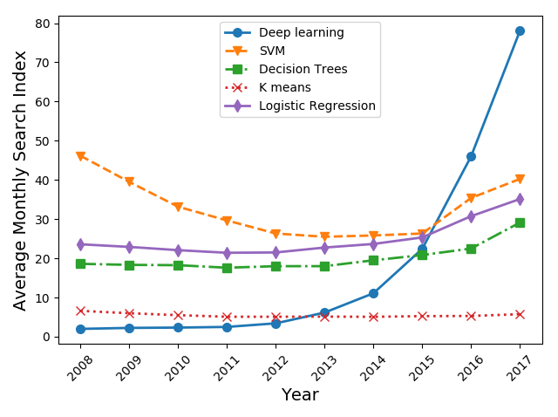
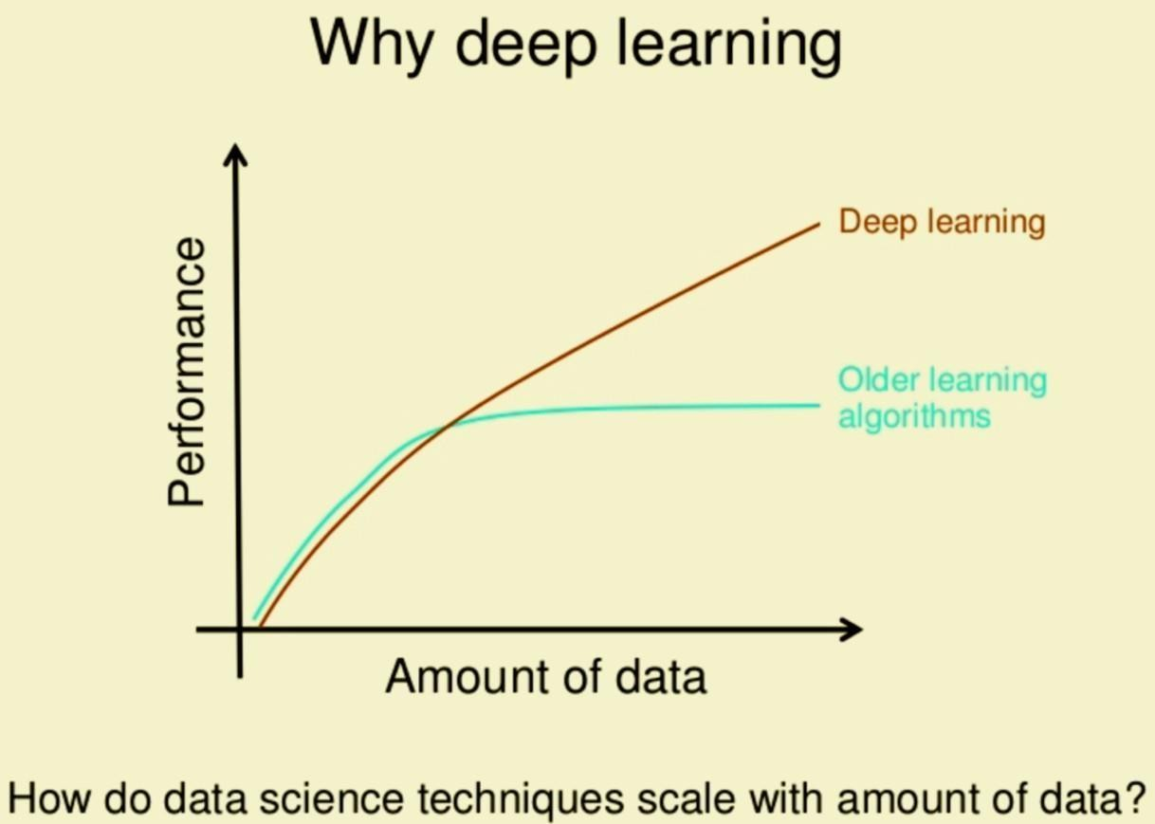
Artificial Intelligence Paradigmshift!
- Machine Learning and Deep Learning?
Promising results if trained with lot of data!

